Slide 1
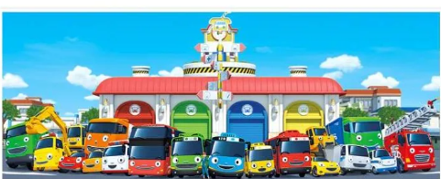
Bus Ticket Booking System
Presented By
Prasad Gawade & Sumeet Katkade

Slide 2
Introduction
This is the project on the online ticketing system of modern coast bus company, which in most cases; the company has problems with their ticketing and scheduling process. This project intends to computerize its semi computerized ticketing system to provide better customer service. Because of that, the company can provide the easier way of travelling to the customer or passenger.Online Bus Ticket Booking System enables the bus company's customer to buy bus ticket online-ticket is the easiest and quickest way to take bus. Sometimes, customer needs to queue up a long queue to buy bus ticket and ask for information. Besides that, customer also not allows buying bus ticket through telephone and Transnational’s telephone line is always busy. This brings a lot of inconvenience to the customers. Online Bus Ticket Booking System enables the customer to buy bus ticket, make payment, cancel reservation and ask for information online easily.

Slide 3
Technology Used
We used Java Spring-Boot as backend and React JS as Frontend in our Project
Spring-Boot :–
The main goal of the Spring Boot framework is to reduce overall development time and increase efficiency. React has become the first choice for frontend because it gives developers the ability to work with a virtual browser (more friendly than the real browser). Also, a JavaScript developer can become a productive developer in a few hours because there is a small API to learn, a few functions, and how to use them…
React :–
React allows developers to create large web applications that can change data, without reloading the page. The main purpose of React is to be fast, scalable, and simple. Spring

Slide 4



User Classes
Customer
Manager
Owner
In this module Customer will register ,update details or and can search for the buses for searching buses select particular Route and make payment after ticket booking
In this module Manager Log into the manager portal.Create the profile,also update/reset password.Manager can add buses routes and haults.Managed the scheduling the buses.Set the prices as per distance.
Log into the portal.Acess all booking data.Set authorization status.Manage bus and update details.

Slide 5
Product Functions
The system provides efficient way to use the service by Customer,Manager and Owner
The System also comprise of updating details and changing Password etc.
Personalized Profile for Customer and Manager
Bus Ticket Booking System is designed to make ticket booking service efficient and smooth for customers.
Also it focuses on ease of all admin functionalities such as managing the details of Bus, Ticket, Bookings, Agents, Seats and reduces human errors.
System is simple, reliable, user friendly, and corrective.

Slide 6
Customer Module
CusCustomer can login to the System.
Customer can register or create profile
Update/reset password
Search for bus
Book his/her ticket
Make a payment

Slide 7
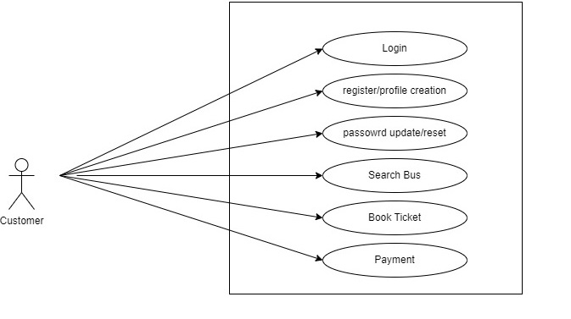
Use Case Diagram For Customer

Slide 8
Manager Module
Log into the Manager portal
Profile creation
Update/reset password
Add buses routes and haults

Slide 9
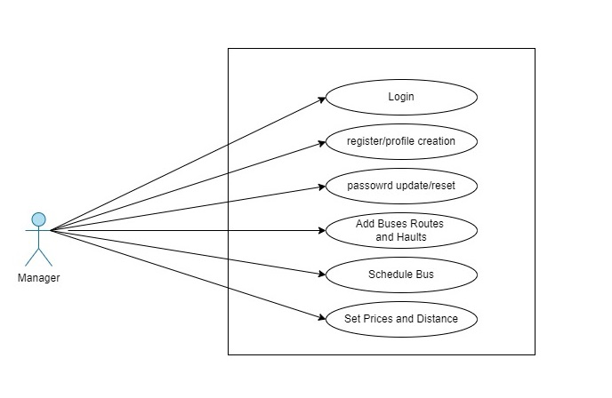
Use Case Diagram For Manager

Slide 10
Owner Module
Log into the portal
Acess All Bookings Data
Set authorization status
Manage bus and update details

Slide 11
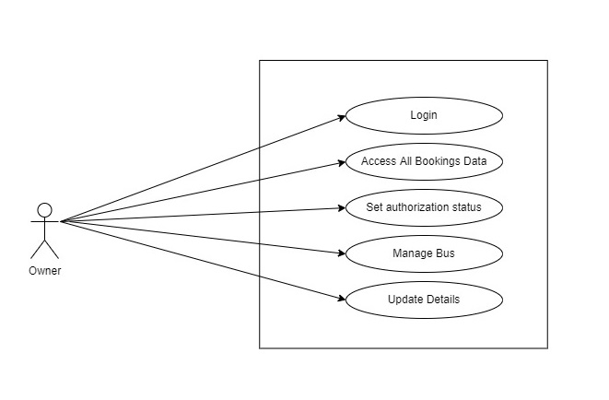
Use Case Diagram For Owner

Slide 12
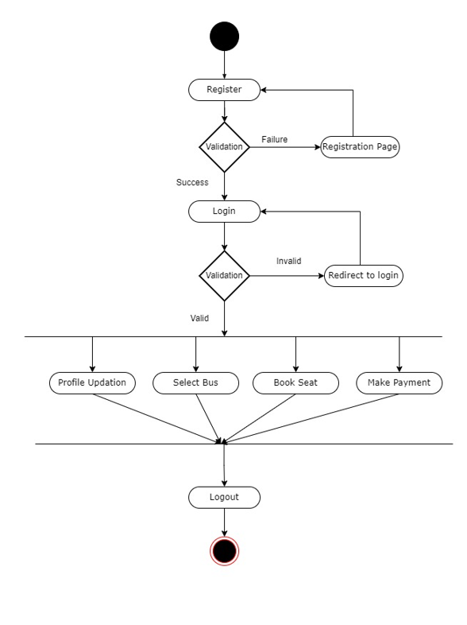
Activity Diagram:Customer

Slide 13
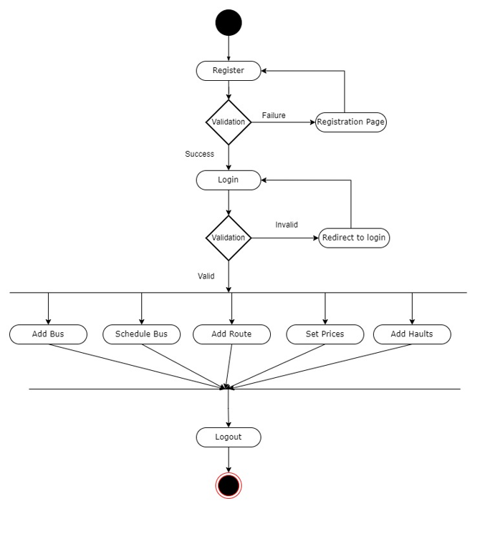
Activity Diagram:Manager

Slide 14
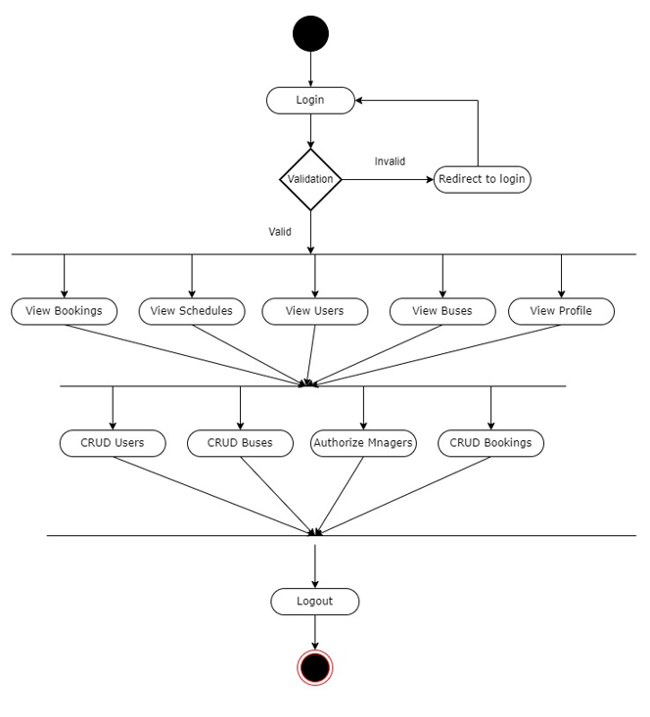
Activity Diagram:Owner

Slide 15
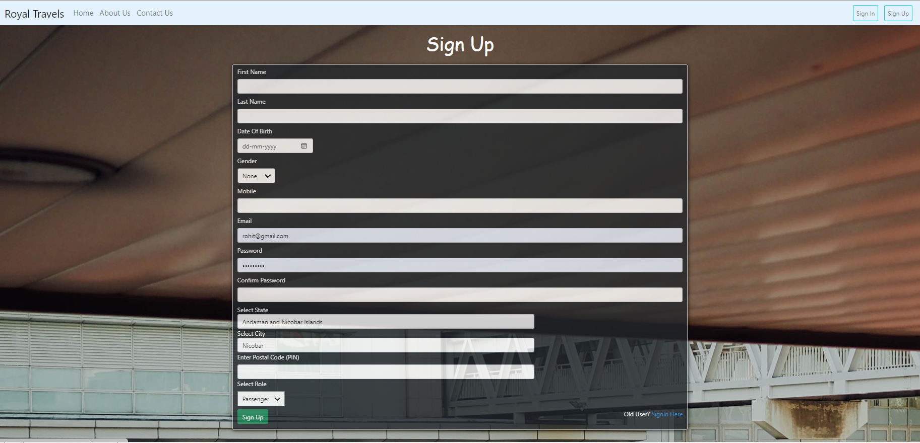

Slide 16
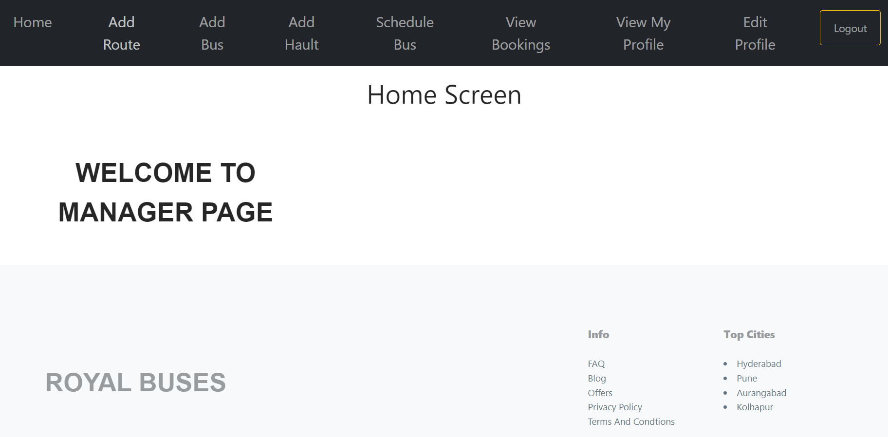

Slide 17
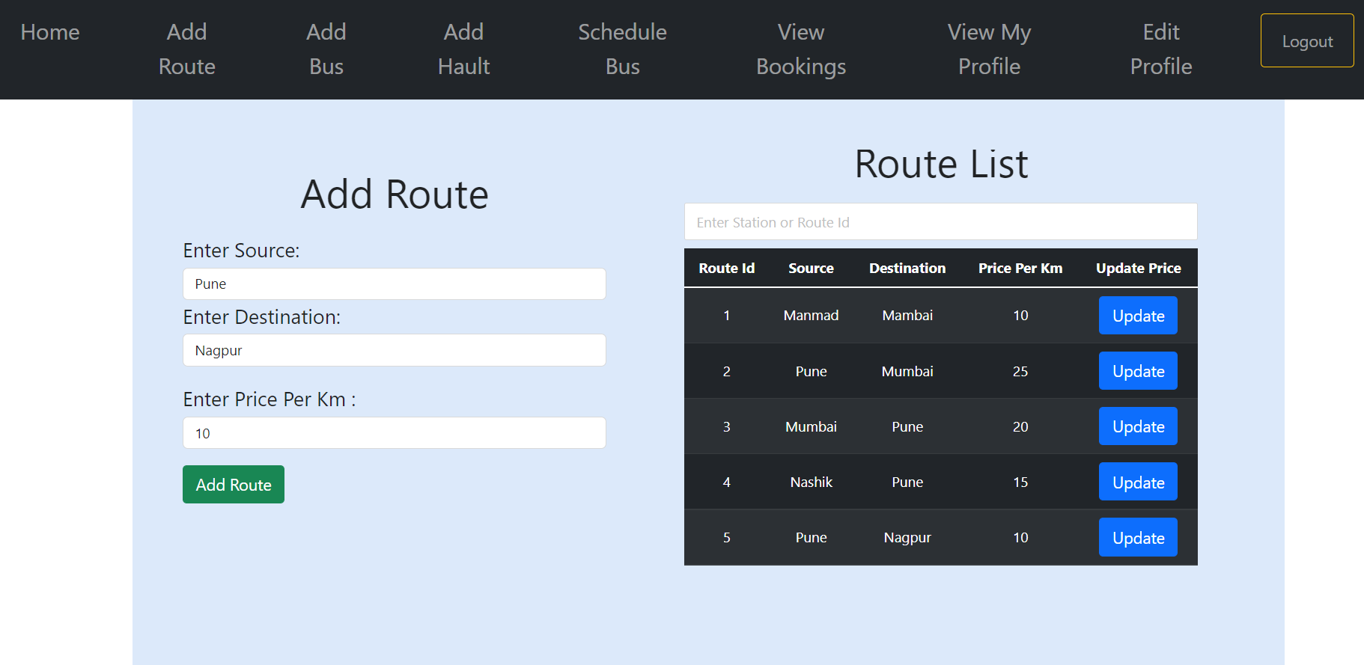

Slide 18
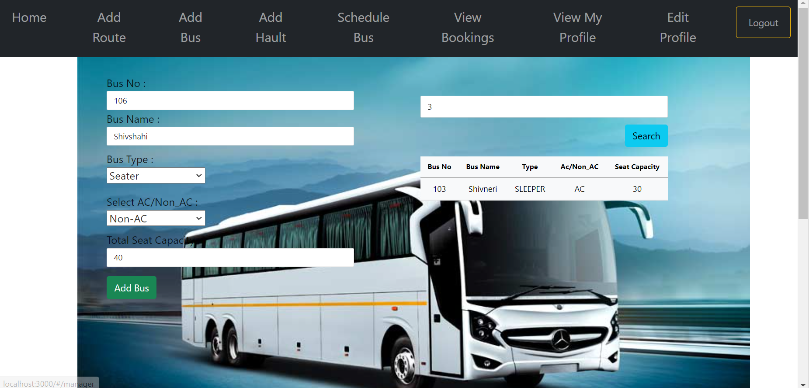

Slide 19
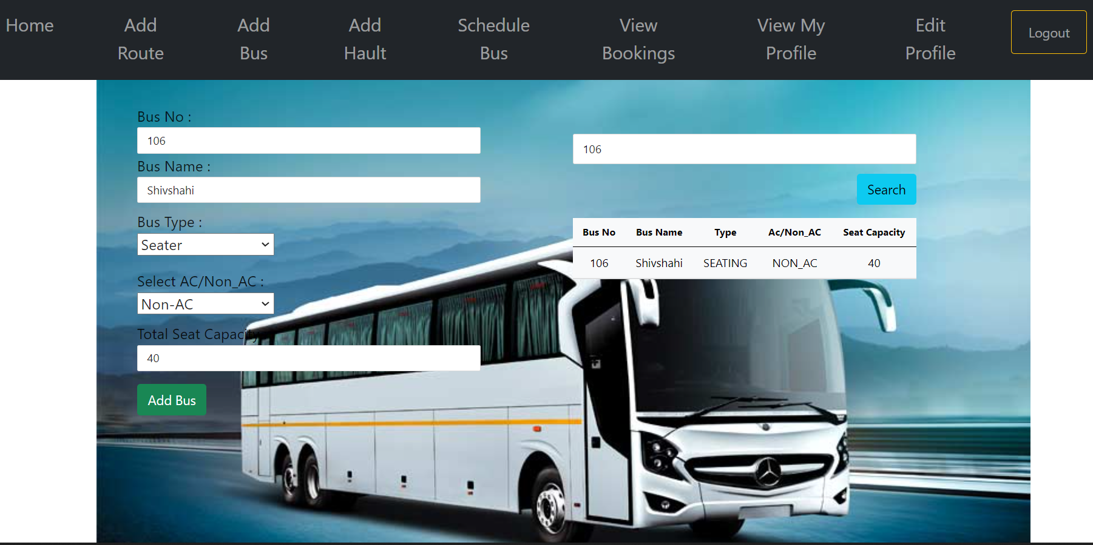

Slide 20
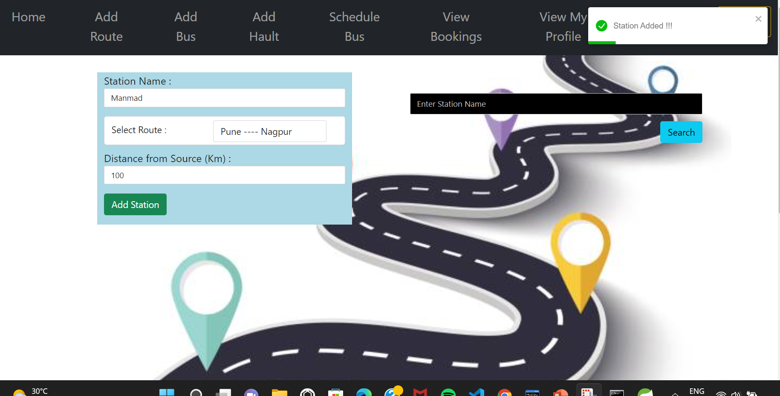

Slide 21
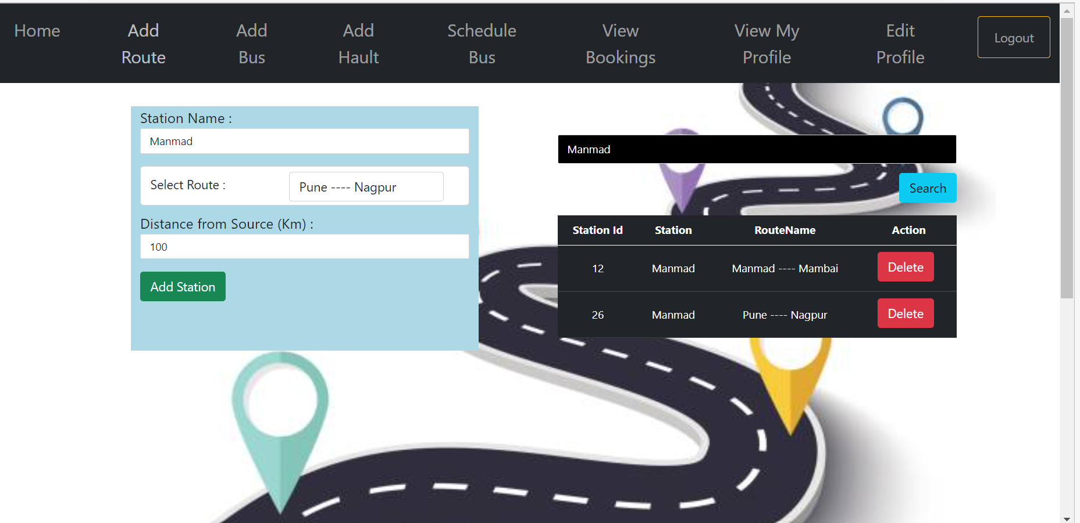

Slide 22
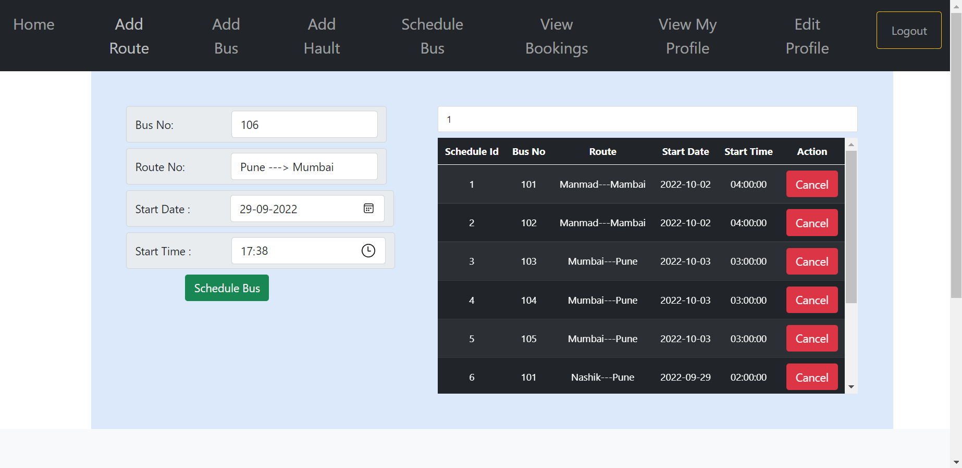

Slide 23
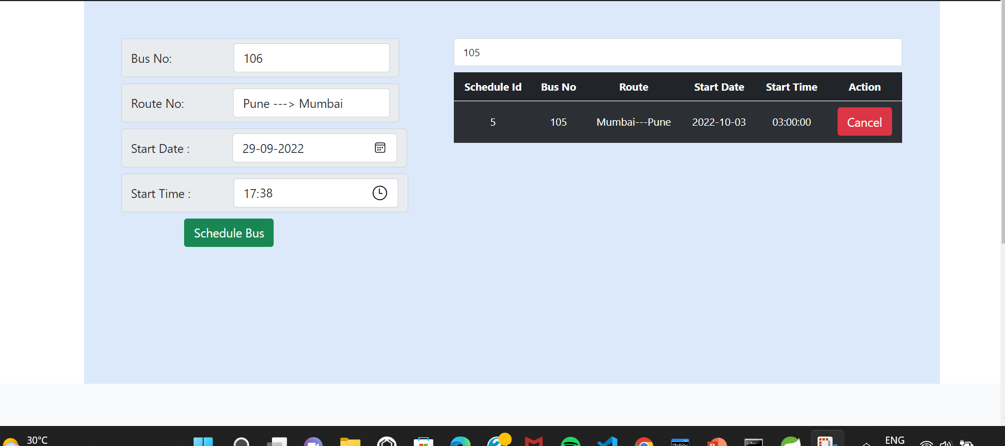

Slide 24
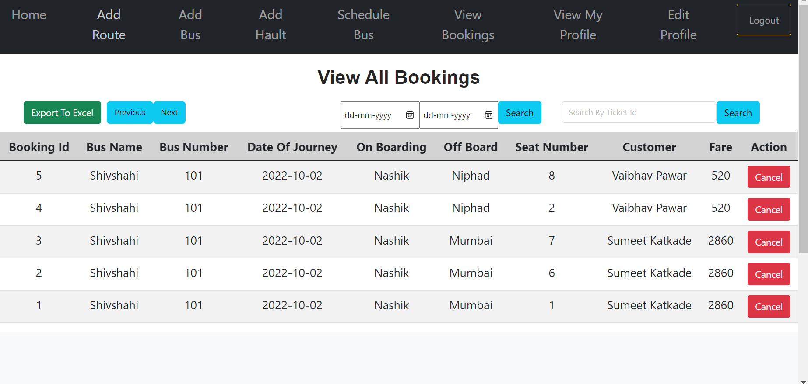

Slide 25
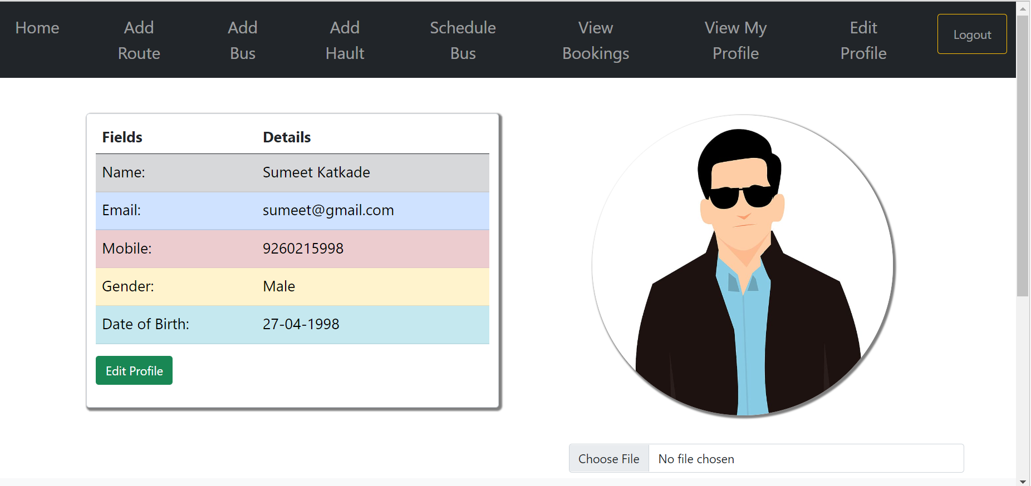

Slide 26
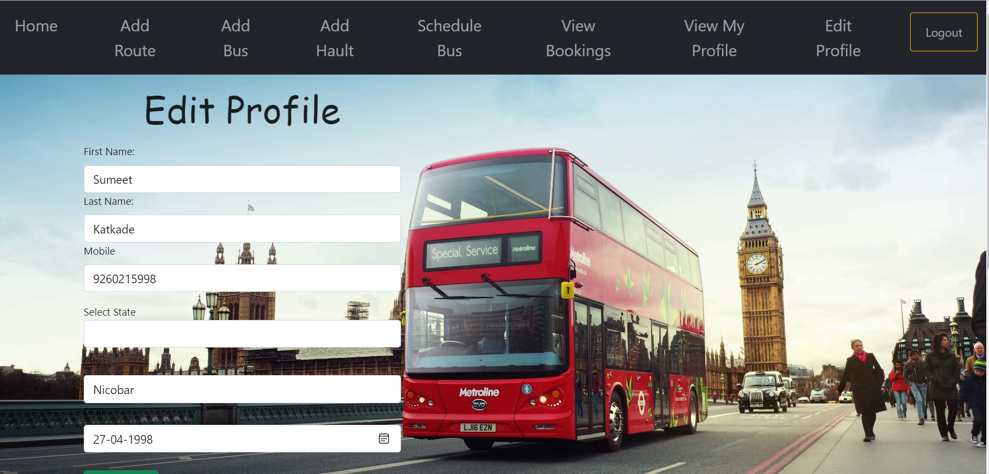

Slide 27
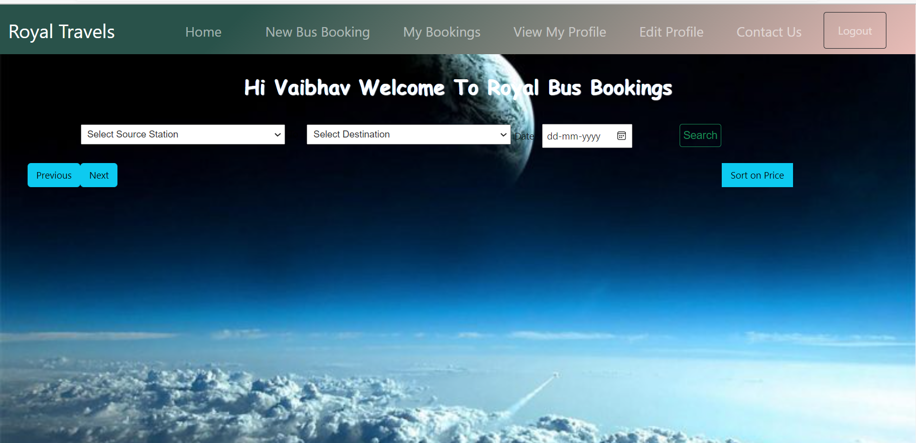

Slide 28
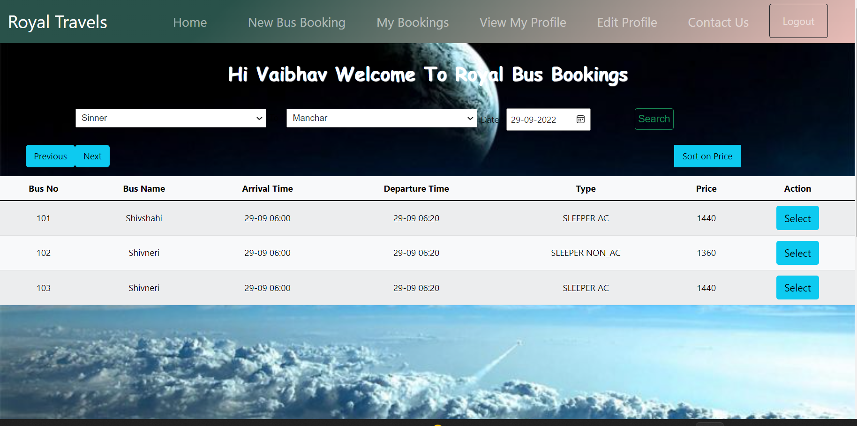

Slide 29
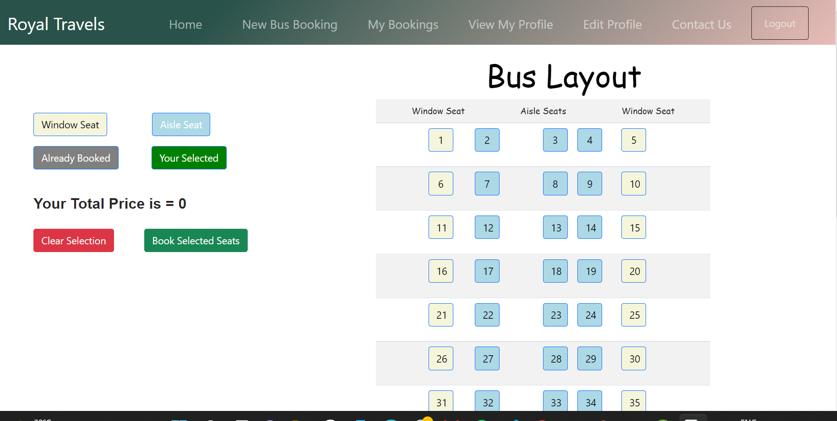

Slide 30
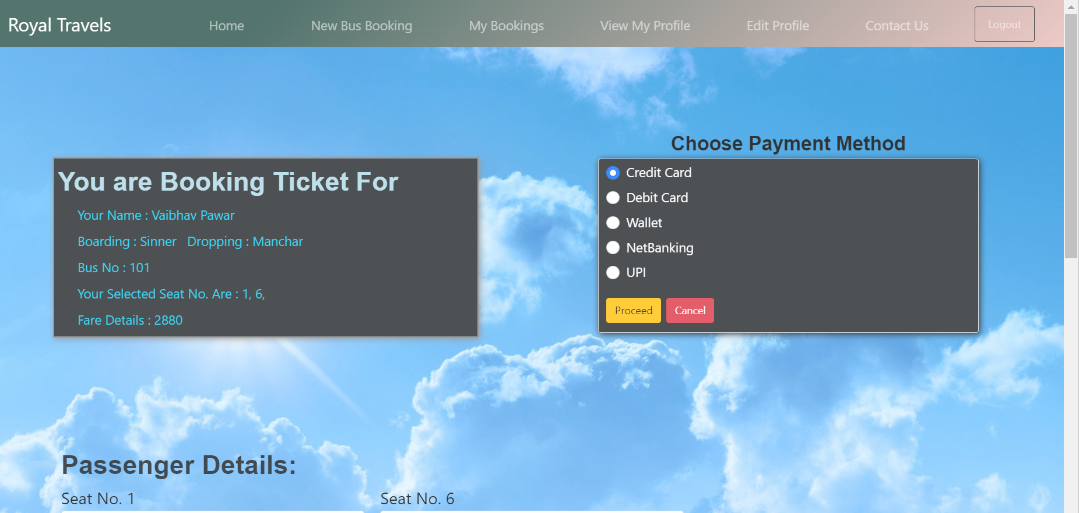

Slide 31
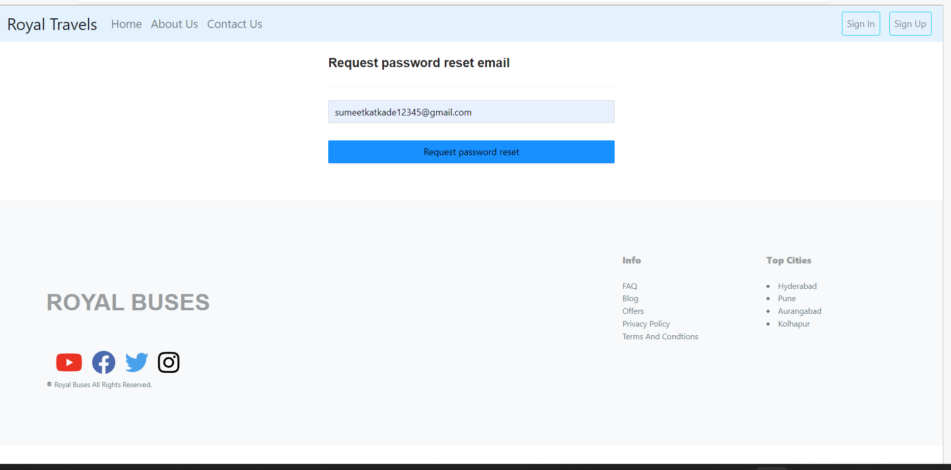

Slide 32
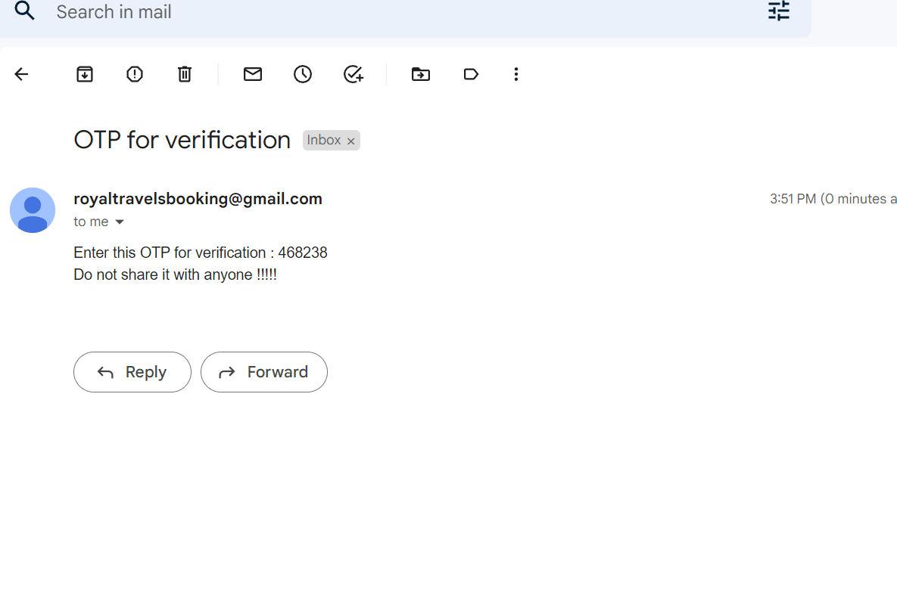

Slide 33
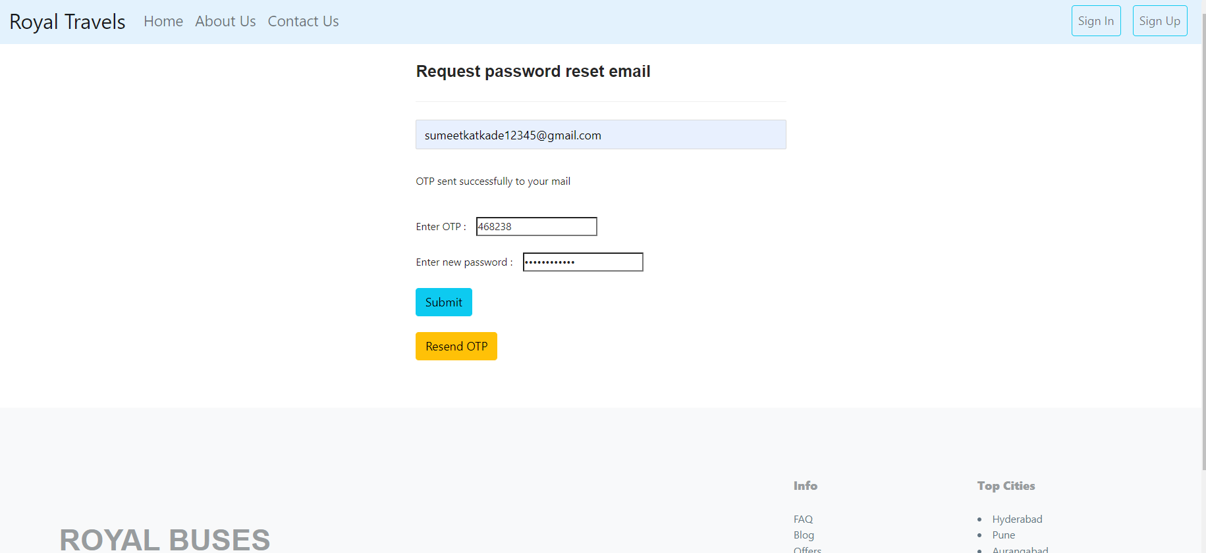

Slide 34
